Slide 1
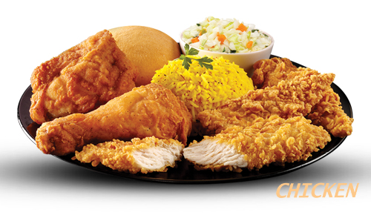
Ashesi Meal Plan
By: aba Amissah debrah

Slide 2
OUTLINE
Introduction
Explorations
Questions
Analysis
Results

Slide 3
INTRODUCTION
A meal plan is a fixed daily amount set aside by individuals for the purpose of purchasing of meals.
Purpose:
Food is important
Budget planning for cafeterias'
Three square meals is important
Source:
Dr Charles Jackson

Slide 4
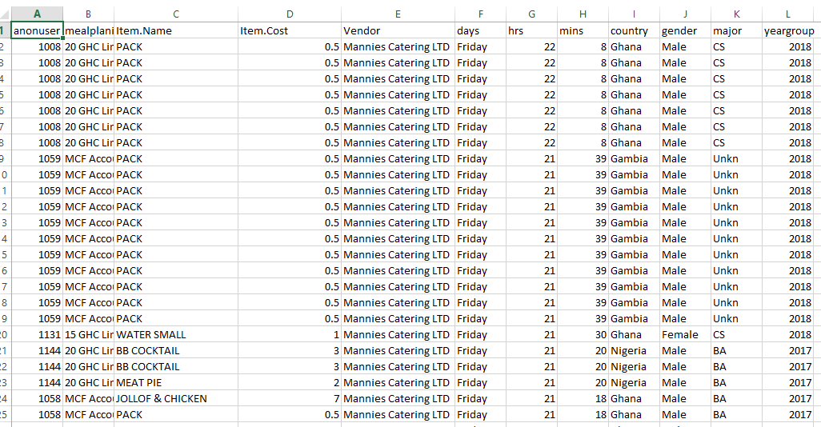
RAW DATA
Notes:
Which food or item is frequent purchased?

Slide 5
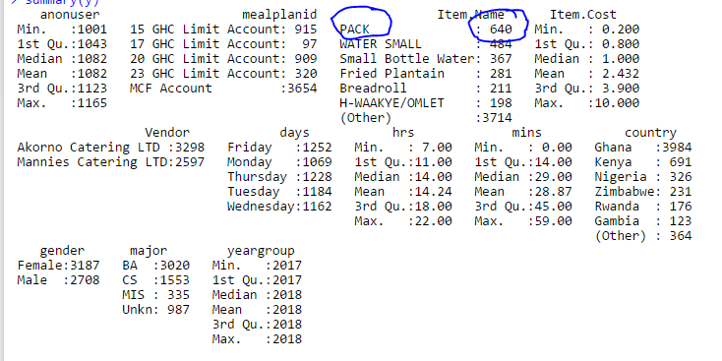
BASIC EXPLORATION

Slide 6
RESEARCH QUESTIONS
Which type of meal plan has the most patronize?
Which cafeteria holds the highest share with the most patronized meal plan?
Which nationality has the highest purchases?
Which course group has the most purchases pertaining to which cafeteria?

Slide 7
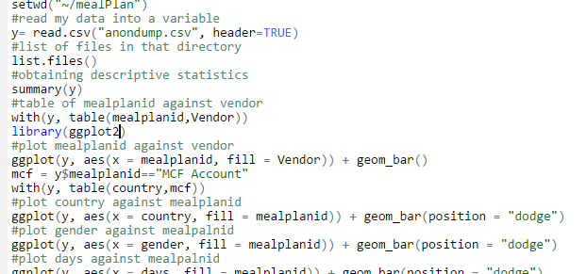
ANALYSIS
Tools & libraries Used:
R Studio
Library: ggplot2, reshape, scale

Slide 8
RESULTS

Slide 9
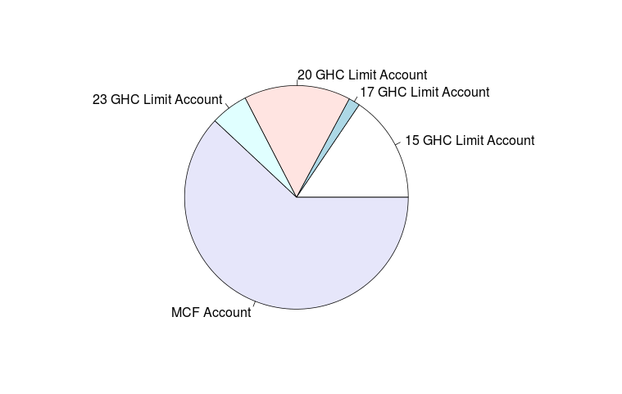
MOST PATRONIZED MEAL PLAN

Slide 10
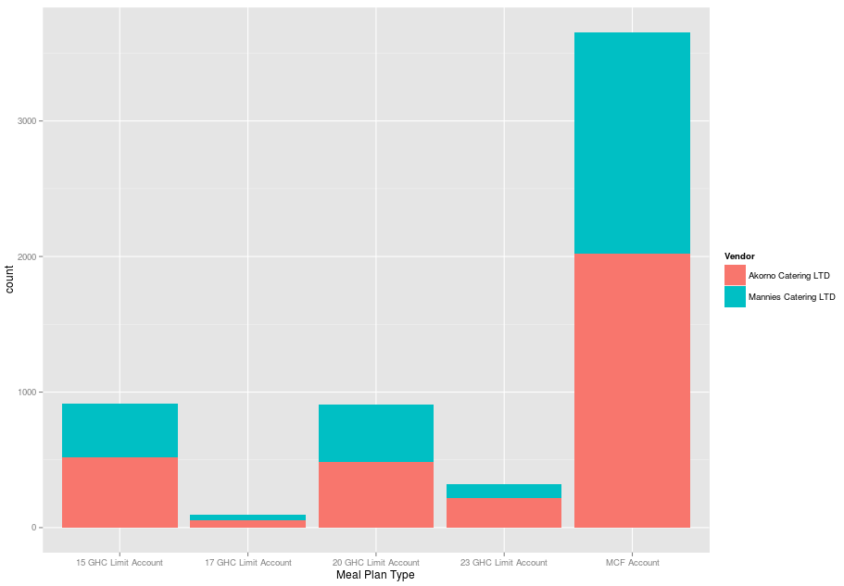
CAFETERIA THAT HOLDS THE MOST PATRONIZED MEAL PLAN
Notes:
Akorno has the most patronized though it

Slide 11
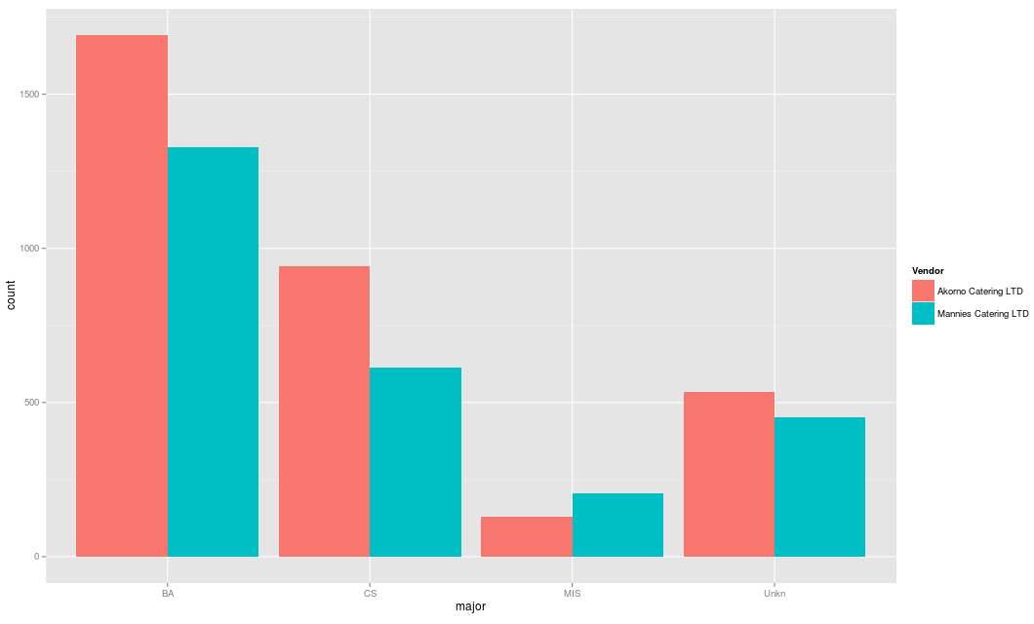
COURSE MAJOR PATRONAGE

Slide 12
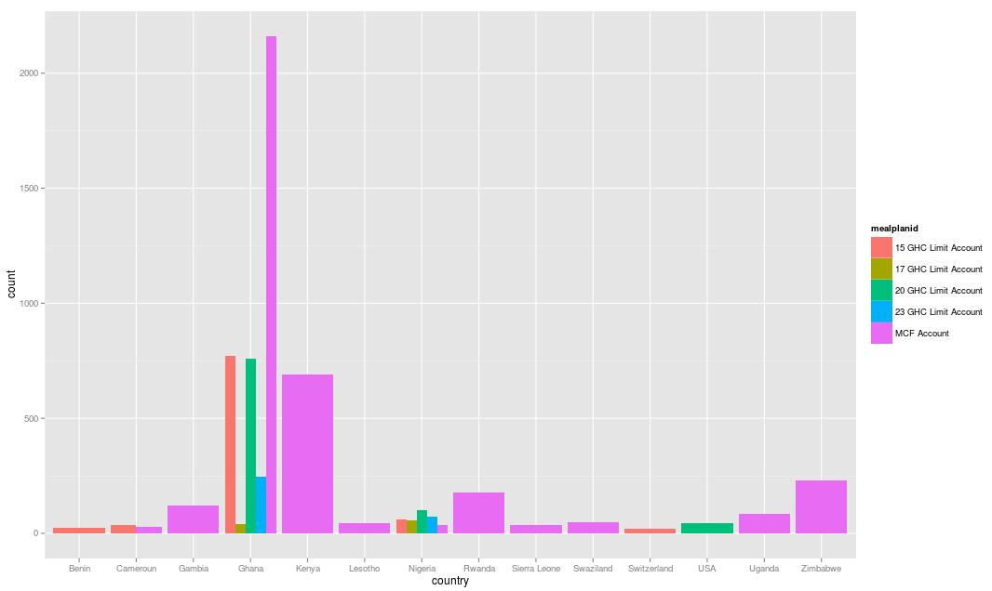
NATIONALITY PATRONAGE

Slide 13
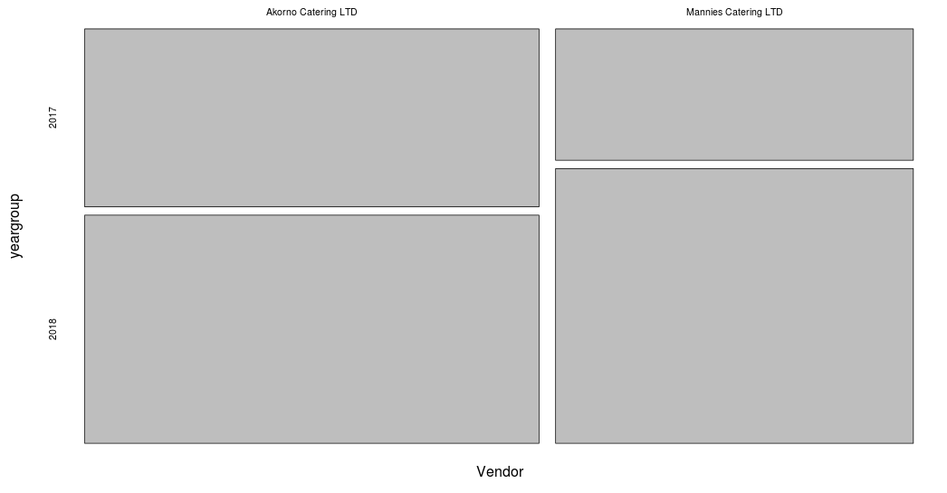
Year Group with Most Purchases
Notes:
Mosaic plot

Slide 14
CHALLENGES
  Issues with R on local laptop

Slide 15
THANK YOU!!!!

